Slide 1
Zomato Orders and Restaurants Analysis

Slide 2
Task 1 SQL :Upload Dataset into PostgreSQL
Created a Data Zomato_DB in Postgres SQL.
Created two table with names Zomato_orders and Zomato_Restaurants with respective Headers given in two data files.
Established Relationship between two tables and imported respective data to two tables.

Slide 3
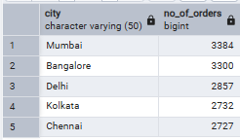
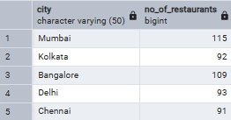
Task 2 SQL: Perform Simple Data Transformations Using SQL
Basic Data Cleaning
Checked for duplicate records for order_id in Zomato_orders and Restaurant_id in Zomato_restaurants.
Checked for NULL values in two tables but found nothing to replace
City wise Restaurant and order count in which Mumbai Top the list in both.

Slide 4
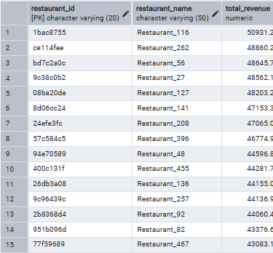
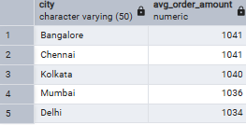
Task 2 SQL: Perform Simple Data Transformations Using SQL
Total revenue generated by each restaurant and can find the Top 5 Restaurant with Highest Revenue In below list.
City Wise Avg Order Amount listed below in which Bangalore Top’s the list.

Slide 5
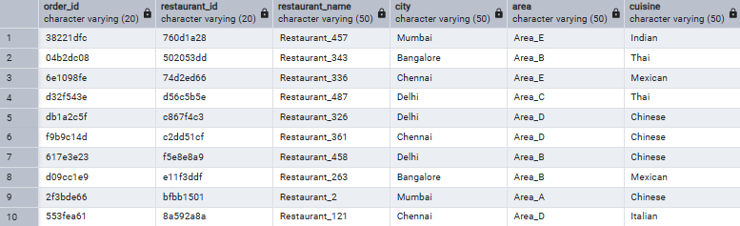
Task 2 SQL: Perform Simple Data Transformations Using SQL
Data Joins and the transformed dataset Exported
Zomato_Orders and Zomato_Restaurants tables Joined using join function to get restaurant names along with order details
Exported and Saved the joined table as Transformed data in an excel format.

Slide 6
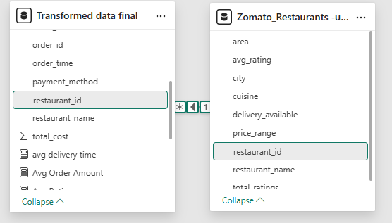
Task 3: Power BI Analysis and Visualization
Import Data
Imported excel file containing transformed data and Zomato_restaurants file in power bi.
Basic Data Cleaning
checked the data types are correctly set in Power Query Editor.
Modeling Data Relationships
Established relationship between two
Tables with Restaurant_id Column.

Slide 7
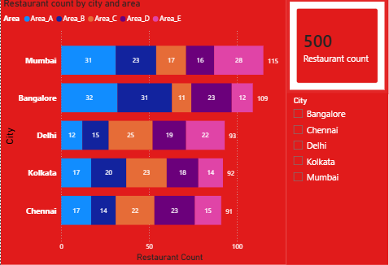
Power BI Task 1: Number of Restaurants per City
City wise Restaurants list
In Total 500 Restaurants,
Mumbai top’s the list with 115 count and Chennai with least 91 count.
We can identify Area and city wise Restaurants counts.

Slide 8
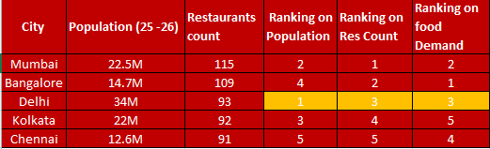
Power BI Task 1: Number of Restaurants per City
Analyzed whether restaurant availability correlates with city population or food demand
We need to focus First on Delhi with high population and food demand to increase Restaurant count with different cuisine.
Next Bangalore and Mumbai based on food demand we can increase Restaurant count with different cuisine.

Slide 9
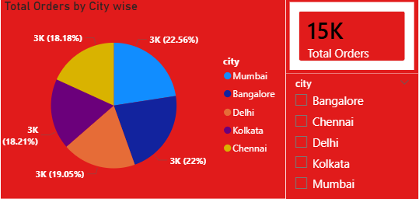
Task 2: Percentage of Orders from Different Cities
City wise Percentage and count of orders
Mumbai top’s the list with 22.56%(3384) and Chennai with least 18.18%.
Mumbai has 115 restaurants Partner which is 23% and Chennai has 91 restaurants partner which is 18.2%.
This Restaurants count % nearly matching with Order %

Slide 10
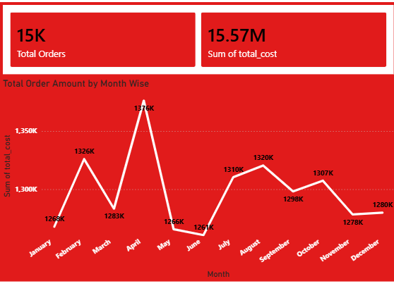
Task 3: Order Amount Trends Over Time
As per chart Total order amount by Month wise
April Month has 1376K Highest Revenue Followed by February second highest and June Month has 1261k Least Revenue followed by May month second least.
Based on January month trend analysis during Pongal festival Season having low Sales and Monday & Tuesday having Low sale compare to other day of week.
Wednesday and Weekend having high sales when compare to other day of week.

Slide 11
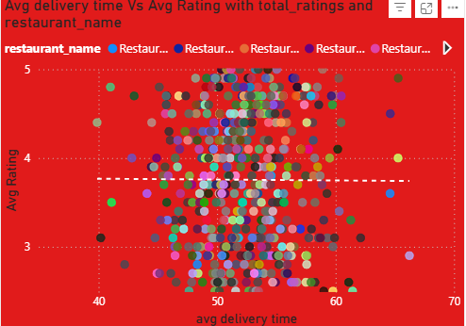
Task 4: Correlation of Factors Affecting Average Rating
Used scatter chart for Avg Delivery time Vs Avg Rating with Restaurant wise.
We can see Trend line which is showing a flat line so there is no correlation with delivery time with rating.

Slide 12
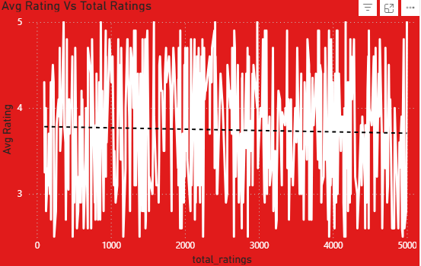
Task 4: Correlation of Factors Affecting Average Rating
Line chart used for Avg Rating Vs Total Rating to find any correlation.
We can see Slight slope in Trend line which indicates higher Total Rating having less avg Rating.

Slide 13
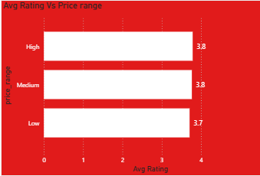
Task 4
Task 4: Correlation of Factors Affecting Average Rating
Bar chart used for Price Range Vs Avg Rating.
We can see not much deviation based on price range so no correlation.
Low price range restaurants having slightly lower avg rating.

Slide 14
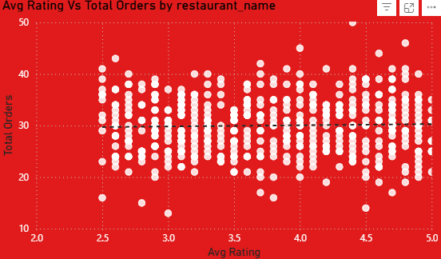
Task 4
Task 4: Correlation of Factors Affecting Average Rating
Scatter chart used for Avg Rating Vs Total Orders with restaurants wise.
Trend line is flat shows no correlation between Avg Rating and Total Orders.

Slide 15
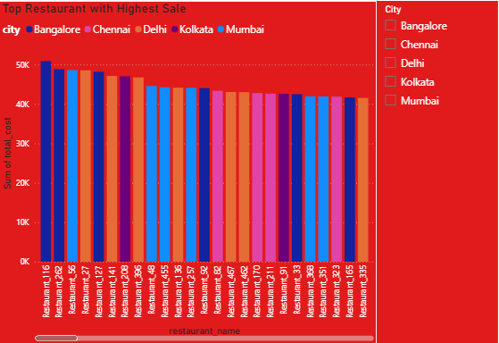
Task 5: Top 5 Restaurants by Total Sales
Top 5 Restaurants with highest revenue are Restaurant 116, Restaurant 262, Restaurant 56, Restaurant 27, Restaurant 127.
Top two belongs to Bangalore.

Slide 16
Task 5: Top 5 Restaurants by Total Sales Analysis
Restaurant_name | city | Area | cuisine | Avg_rating | Total_ratings | Price_range
Restaurant_116 | Bangalore | Area_C | Indian | 4.8 | 982 | Low
Restaurant_262 | Bangalore | Area_D | Mexican | 2.5 | 1388 | Medium
Restaurant_56 | Mumbai | Area_E | Thai | 4.6 | 2336 | Low
Restaurant_27 | Delhi | Area_E | Italian | 2.6 | 542 | High
Restaurant_127 | Bangalore | Area_B | Indian | 4.4 | 3888 | High

Slide 17
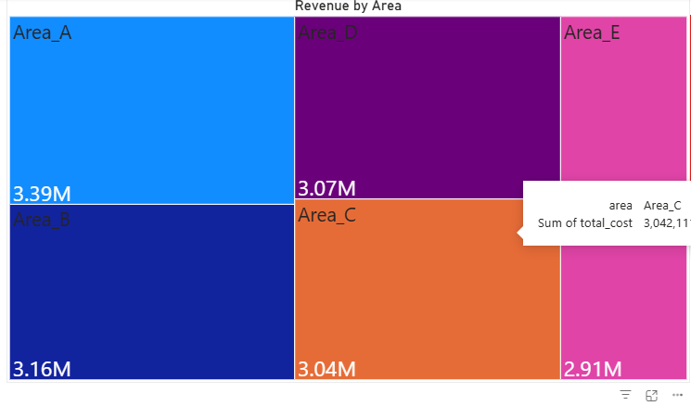
Task 6: Revenue by Area Using a Tree Map
Area A has Highest Revenue and Area E has least Revenue.

Slide 18
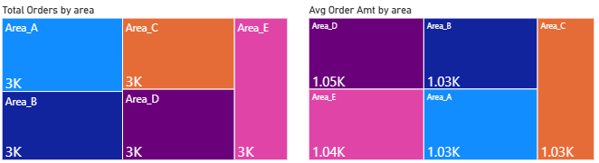
Task 6: Revenue by Area Using a Tree Map
Order per Area is not Effecting Revenue and Avg Amount has no Effecting the area wise Revenue

Slide 19
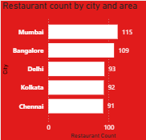
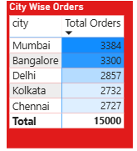
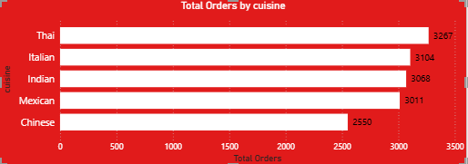
Task 7: Order Density by City Using a Heat Map
If we rank City wise Restaurants count it is matching with Ranking of City wise orders count.
So Supply is meeting the Demand.
Cuisine orders count in which Thai top list.

Slide 20
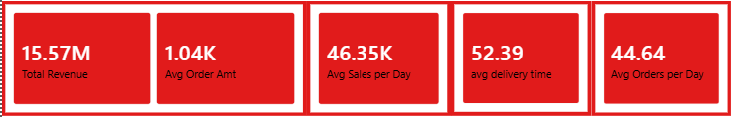
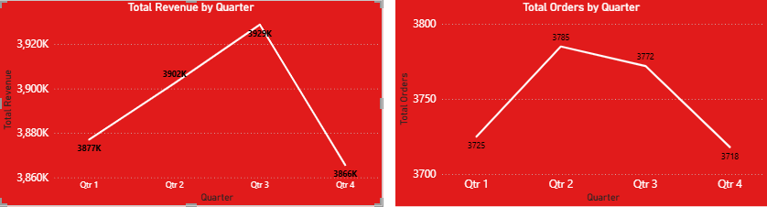
Task 8: KPI Cards – Total Revenue & Average Order Value
If we see Revenue Trend Quarterly wise Q3 having Peak and Q4 is low.
If we see Orders count Trend Quarterly wise Q2 having Peak and Q4 is low.

Slide 21
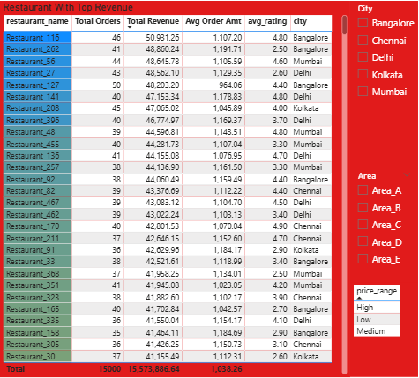
Task 9: Restaurant-Wise Sales Summary in a Table

Slide 22
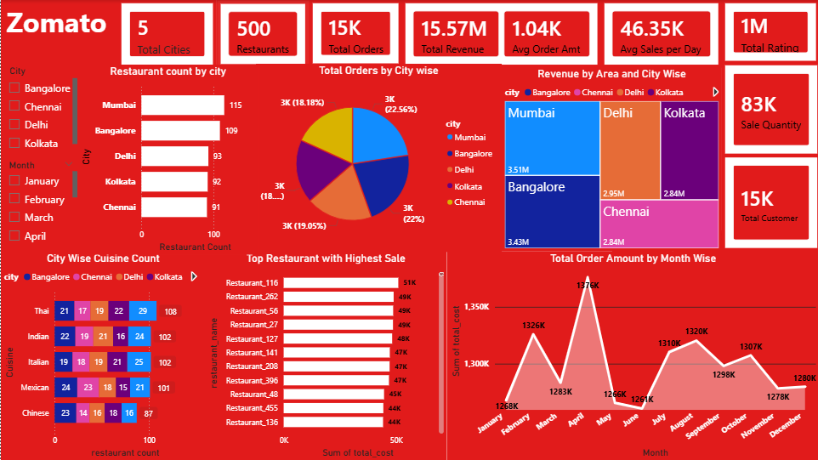

Slide 23
Recommendations
Avg orders day is 44.6 but we have 500 restaurants in total which means near 455 Restaurant having zero orders daily basis.
Improve Visibility and pricing strategy to increase orders and revenue
Join Recommended and Trending sections in Zomato
Use high-quality food images
Keep menu names simple and searchable
Use combo offers (meal + drink)
Add ₹99 / ₹149 budget items
Apply limited-time discounts (10–20%) during non-peak times.
Highlight top-selling items
Remove slow-moving dishes for menu optimization.

Slide 24
Recommendations
We can reduce avg delivery time 52.39 min by Keeping preparation time accurate and increasing Delivery agents count Based on demand daily basis.
Giving offers and discount on Weekdays like Monday, Tuesday and Thursday to increase sales which having lower sale compare to other days.
First need to focus on Delhi city for expansion which has higher population and Food demand (due to Heavy traffics) with different cuisines which are having high demand.
In Bangalore and Delhi city Restaurants Generating high sales Revenue with cuisines Mexican and Italian but having low rating so need improvement in food Quality

Slide 25
THANK YOU

